Slide 1
Teacher Recruitment and Retention
ArchKCK Task Force Findings
Notes:
Felicia

Slide 2
Task Force Objectives
Felicia
Identify better avenues to recruit teachers.
Identify where to reach specific teachers groups (e.g. veteran, retired, new grads, career changers, public school)
Compare current compensation and benefits package to identify needs and gaps.
Identify messaging to better reach and persuade teachers to work in Catholic schools.
Identify retention strategies to keep teacher in Catholic schools.
Notes:
Felicia

Slide 3
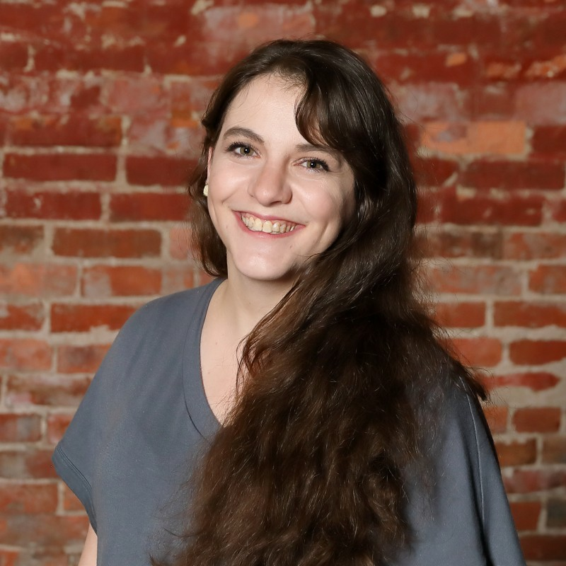
Felicia Holcomb
Felicia
Consultant for Marketing and Enrollment Management
Office of Catholic Schools
Archdiocese of Kansas City in Kansas
fholcomb@archkckcs.org
Commission on Education Member
Facilitator for Teacher Recruitment & Retention Task Force
Notes:
Felicia

Slide 4
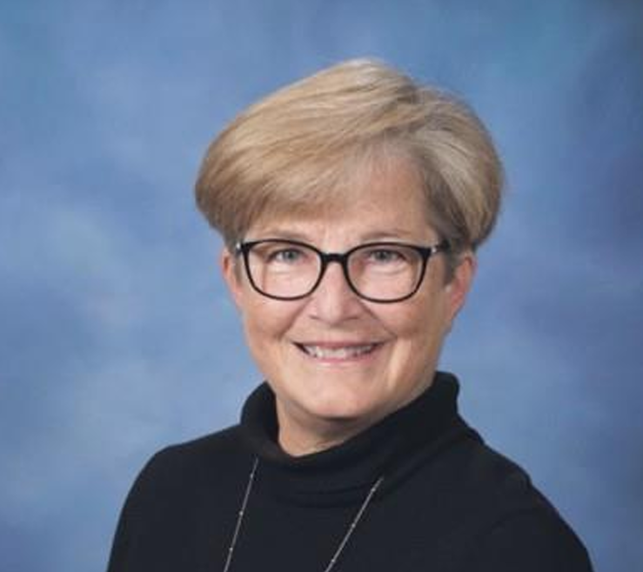
Jane Sullivan
Jane
Principal
St. Agnes Catholic School, Roeland Park, KS
Archdiocese of Kansas City in Kansas
sullivan.jane@stagneskc.org
Teacher Recruitment and Retention Task Force Member
Notes:
Jane

Slide 5
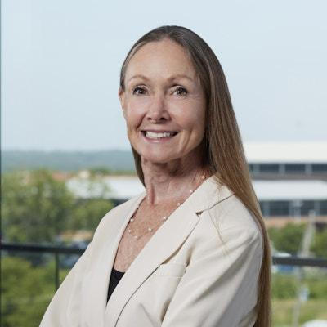
Lilli Zarda
Lilli
CPA at Creative Planning Strategic Advisors
Board Member at Resurrection Catholic School (KCK)
lillizarda@gmail.com
Commission on Education Member
Facilitator for Teacher Recruitment and Retention Task Force
Notes:
Lilli

Slide 6
Data
Lilli
ArchKCK Benefits
Public school benefits and KPERS
Student loan forgiveness programs
Tuition remission policy
School leaders survey
Retired teachers survey
Other dioceses benefits and structure
Testimonials
Exit interview
Notes:
Lilli

Slide 7
Data Continued
Lilli
KAIRS Teacher Survey
ArchKCK Salary Study
Average teacher salary by state
Demographic breakdown of ArchKCK teachers
Catholic school parents teaching in public schools
Job application history
Application referral sources
Website and social media content engagement
New teacher survey
New hire comparison
Notes:
Lilli

Slide 8
Why Teachers Do Not Work in ArchKCK Schools
Jane
Compensation is less than public schools
Compensation is varied regionally, with outliers at both grade school and high school levels
Benefit packages are not fully understood or effectively communicated during the recruitment process
Tuition remission is inconsistently applied
Student loan forgiveness programs are not understood
Notes:
Jane

Slide 9
Why Teachers Do Not Work in ArchKCK Schools Continued
Jane
Lack of teacher and staff racial diversity
Timeline of job openings, contracts, and hiring process is delayed
Pre-service teachers have already made up their minds about schools / communities before they are juniors and seniors in college
Increasing disinterest in the field of education
Notes:
Jane

Slide 10
Why Teachers Leave ArchKCK Schools Continued
Jane
Compensation is less than public school, especially as teachers’ years of experience increases and master’s degrees are earned
Benefit packages are not fully understood and not utilized to their full capacity
Tuition remission is inconsistently applied (e.g. grade school teachers leave school when a child enters high school, higher pay at the high school level)
Lack of mentorship
Lack of teacher and staff racial diversity
Notes:
Jane

Slide 11
Why Teachers Leave ArchKCK Schools Continued
Jane
Lack of collaborative opportunities (e.g. one class per grade level)
Negative environment
Increasingly tasked with non-instructional tasks
Lack of support from administration
Lack of work-life balance
Notes:
Jane

Slide 12
Avenues for Teacher Recruitment
Felicia
New graduates
Catholic campus centers (non-education majors)
Public school teachers
Retired teachers
Career changers (Transition to Teach programs)
Online platforms (e.g. Indeed, archkckcs.org, LinkedIn, etc.)
Traditional marketing (e.g. parish bulletins, The Leaven, etc.)
Word of mouth from families and friends
Notes:
Felicia

Slide 13
Messaging to Better Reach and Recruit
Felicia
Compensation comparisons
ArchKCK benefits vs. KPERS (401K)
Tuition remission
Student loan forgiveness
Testimonials and highlighting of:
Faith formation
Academics and curriculum
Teacher autonomy
Safety
High expectations
Parent involvement
Professional development
Notes:
Felicia

Slide 14
Task Force Recommendation:
Strategic Plan
Felicia

Slide 15
Objectives and Yearly Goals - Recruitment
Felicia
Increase Qualified Applicants: 2% annual increase in teacher applications.
Engage Recent Graduates: 50% more participation in college events.
Recruit from Public Schools: Target 30% of the applicant pool to be public-school educators.
Inspire Future Educators: Establish "Grow Your Own" initiative by May 2025.
Notes:
Felicia

Slide 16
Key Strategies
Felicia
Visibility: Increase presence at career fairs and online.
Marketing: Utilize digital platforms to highlight Catholic school teaching benefits.
Partnerships: Develop campaigns and seek funding for teacher incentives.
Vocational Support: Offer scholarships and career exploration for students.
Notes:
Felicia

Slide 17
Implementation Strategies
Felicia
Career Fairs: A representative from the Office of Catholic Schools and/or Archdiocesan Catholic schools will attend career fairs at four year universities and community colleges.
Marketing: The Office of Catholic Schools will increase brand awareness and audience engagement through evidence-based marketing practices and digital marketing practices on Facebook, Instagram, Twitter, and LinkedIn (see Strategic Marketing Plan, Outcome 2, 4, 5).
Notes:
Felicia

Slide 18
Implementation Strategies Continued
Felicia
Marketing: The Office of Catholic Schools will consistently use recruitment messaging that highlights the top reasons candidates apply / work in Catholic schools. These include: practicing and sharing their faith; positive and faith-filled community and culture; high expectations for student behavior and academics; parent involvement; and tuition remission (see Strategic Marketing Plan, Outcome 4 & 5).
Notes:
Felicia

Slide 19
Implementation Strategies Continued
Felicia
Marketing: The Office of Catholic Schools will use marketing to address misconceptions that exist related to the competitiveness of compensation, benefits, and retirement / 401(K) (see Strategic Marketing Plan, Outcome 4 & 5).
Benefits: With HR, the Office of Catholic Schools will facilitate a yearly training for principals and hiring managers on explanation of benefits for recruitment and hiring purposes, focusing on those benefits most appealing to recruits. These include: medical; dental; vision; 401K; tuition remission; mental health support through and EAP equivalent; and My Catholic Doctor.
Notes:
Felicia

Slide 20
Implementation Strategies Continued
Felicia
Public School Teacher Event: The Office of Catholic Schools will hold a minimum of one (1) Fall and one (1) Spring recruitment event strategically marketed to Catholics teaching in public schools.
Career Changer Event: The Office of Catholic Schools will hold a minimum of one (1) Fall and one (1) Spring recruitment event strategically marketed to individuals considering a career change into education.
Annual Weekend: The Office of Catholic Schools will coordinate with parishes and principals an annual weekend information event in which a Catholic school representative is present after parishes’ weekend Masses to answer questions about working in Catholic schools.
Notes:
Felicia

Slide 21
Implementation Strategies Continued
Felicia
Year Long Advertising: The Office of Catholic Schools will work with The Leaven on a year-long advertisement campaign promoting working in Catholic schools.
Teacher Referral: The Office of Catholic Schools will explore possible funding options or models for a teacher referral program.
Sign-on Bonuses: The Office of Catholic Schools will continue to explore possible funding opportunities for sign-on bonuses and compensation increases for teachers.
Notes:
Felicia

Slide 22
Task Force Recommendation:
Strategic Plan - Retention
Lilli
Notes:
Lilli

Slide 23
Objectives and Yearly Goals - Retention
Lilli
Increase Teacher Salaries: Match or exceed 80% of public school salaries, inclusive of higher degrees.
Ensure Continuity of Tuition Remission: Standardize tuition remission across all schools, to include preschool and early learning centers.
Focus on Faith Formation: Fulfill teachers’ spiritual enrichment needs.
Exit Surveys: Understand and act on reasons for teacher turnover.
General Benefits Enhancement: Make benefits a compelling factor in recruitment and retention efforts.
Building Community: Strengthen school culture and community.
Notes:
Lilli

Slide 24
Key Strategies
Lilli
Financial Analysis: Determine the impact and feasibility of salary adjustments
Best Practices Research: Explore successful salary increase programs
Legislative Advocacy: Leverage school choice and tax credits for financial empowerment
Survey Implementation: Require exit surveys for all departing staff and all staff survey for faith formation programs’ effectiveness
Benefit Transparency: Communicate all benefits and evaluate subsidies for teacher health plans
Principal Meetings: Share and discuss effective community-building strategies
Team Building Activities: Facilitate events to enhance collegiality and morale
Notes:
Lilli

Slide 25
Implementation Strategies
Lilli
Team Approach to Career Fairs: The Office of Catholic Schools will coordinate with Archdiocese principals to increase representation at career fairs.
Career Fairs: A representative from the Office of Catholic Schools and/or Archdiocesan Catholic schools will attend career fairs at universities and community colleges.
Education Departments: A representative from the Office of Catholic Schools and/or Archdiocesan Catholic schools will host an event or visit with the education department at universities.
Catholic Campus Centers: A representative from the Office of Catholic Schools and/or Archdiocesan Catholic schools will host an event or visit the Catholic campus centers at universities.
Notes:
Lilli

Slide 26
Implementation Strategies Continued
Lilli
Student Teaching: The Office of Catholic Schools will invite universities and students to an information event on student teaching and observing in Archdiocesan schools to increase college student involvement in schools.
Teacher Experience: The Office of Catholic Schools will consider hosting a Catholic School Teacher Experience that includes a school Mass, talking with teachers, visiting several schools, and a social hour to increase the excitement and understanding of teaching in Catholic schools.
Notes:
Lilli

Slide 27
Strategic Priorities - Recruitment & Retention
Jane
Salary Enhancement: Financial analysis and adoption of best practices.
Benefits Optimization: Standardize tuition remission; communicate benefits effectively.
Faith Formation: Assess and develop faith enrichment programs.
Systematic Feedback: Implement exit surveys and leadership reviews.
Community Building: Strengthen school culture with collaborative events.
Notes:
Jane

Slide 28
Implementation Timeline
Jane
Year 1: Analysis and policy standardization.
Year 2: Legislative advocacy and benefits extension.
Year 3: Evaluation of strategies and community enhancement efforts.
Yearly evaluation with reporting to Education Commission and OCS Annual Review
Notes:
Jane

Slide 29
For teacher retention, what do you do to create a positive, collaborative culture?
Jane
Notes:
Jane

Slide 30
For student retention, what do you do to create a positive, collaborative culture?
Jane
Notes:
Jane

Slide 31
What can you do at the school level?
Felicia
Be fluent in your benefits.
Highlight the things that make Catholic schools different than public or private schools. Know what makes your individual school unique.
Create marketing materials that are for recruitment of families AND teachers.
Utilize social media and community connections to increase brand awareness.
Notes:
Felicia

Slide 32
What can you do at the school level?
Felicia
Consider a teacher referral program.
Evaluate current tuition remission implementation for consistency.
Evaluate your compensation and pay scale in comparison to neighboring public and Catholic schools. What incentive is there for teachers to get a Master’s degree?
Host teacher information events and/or shadow days. Approach recruitment of teachers and staff similar to student recruitment.
Notes:
Felicia

Slide 33
What can you do at the school level? Continued
Felicia
After a teacher accepts a position, have a formal or informal questionnaire to better understand what made them choose your school.
Gather testimonials from present and retired teachers and staff and highlight on social media and marketing materials.
Ask teachers and staff to leave online reviews on Google, Facebook, Niche, Great Schools, Private School Reviews, etc.
Form a social committee with specific objectives to increase social activities.
Form a parent-led teacher and staff appreciation group. Activities should be more than NCSW and Teacher Appreciation Week.
Notes:
Felicia

Slide 34
What can you do at the school level? Continued
Felicia
Reflect on and assess your current administrative efforts to increase morale and collaboration in your school.
Ask teachers and staff for feedback on their spiritual formation wants and needs.
Conduct a focus group without the school leaders present (ideally, have a third party lead) to identify ways to improve the school culture.
Conduct exit interviews and send out surveys to all teachers leaving (retiring, staying at home, going to another Catholic school, changing careers).
Notes:
Felicia

Slide 35
What can you do at the school level? Continued
Felicia
Educate teachers and staff on work-life balance.
Preserve teacher plan time.
Develop / improve new teacher mentorship programs (beyond just year 2).
Notes:
Felicia

Slide 36
Create a Calendar
Felicia
Month / Date | Activity | Recruitment | Retention | Responsible Parties / Details
April 2 | Open House Event for Current Teachers and Prospects | X | X | Mass - Name Marketing - Name Setup of Library - Name Call prospective teachers - Name Purchase snacks - Name Prepare presentation- Name Teachers to give testimonials - Name Game organization and hosting - Name
April 4 | Thank You | X |  | Thank you to prospects that joined

Slide 37
Create a Calendar
Felicia
Month / Date | Activity | Recruitment | Retention | Responsible Parties / Details
Weekly | Social Media post for recruitment | X |  | 1st Thursday of the month - why work in Catholic schools 2nd Thursday of the month - teacher testimonial 3rd - parent testimonial 4th - live from our classroom

Slide 38
Questions?

