Slide 1
CFNEK Stewardship and Development Symposium:
How to build a successful event
AMY MEARA
Catholic Education Foundation
Director of Special Events

Slide 2
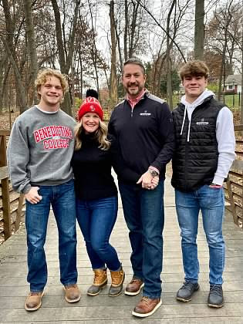
Amy Meara
Director of Special Events
Catholic education Foundation
Graduate of Benedictine College, BA in mass communications with an emphasis in public relations, a minor in education
Executive Assistant and Race Director at the KC Affiliate of the Susan Komen Foundation
Director of Premedical Programs at The University of Kansas School of Medicine
Director of Alumni Relations at Benedictine College
Notes:
This is just a little bit about myself. I’ve always done events. In high school, I was on the dance committees and what not, in college I was the student government social chair for two year and the student orientation director for two years. Events have always just been my thing. I didn’t know I could make a career out of it!

Slide 3
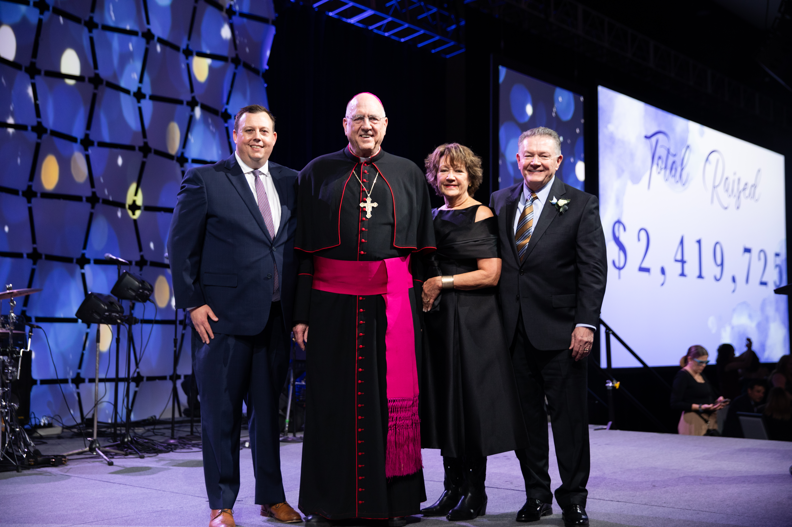
How to run a successful event
8 steps
1. Set your goal.
2. Create a budget.
3.Fundraise or secure sponsorships.
4. Design your event.
5. Recruit volunteers.
6. Market your event.
7. Host your event.
8. Follow up!
Notes:
Now the key to any successful event is to see how others have done it, so while putting together this presentation I found a few difference resources to help me create an outline ☺ There’s nothing wrong with a little copy and pasting in the event planning world – don’t reinvent the wheel if you don’t have to!

Slide 4
Set your goal
What is the purpose of the event?
What cause are we promoting with this event?
What type of event is this? (Party, Dinner, Get-Together, Auction, Gala)
What is our goal for the event? (Raise awareness, Fundraising)
What expectations will the guests have for this event?
WHO?
WHAT?
WHERE?
WHEN?
WHY?
Notes:
Within this part of planning, it’s a good idea to look around and see who else is planning events and what kinds of events they are hosting. ALWAYS check other calendars! You don’t want to plan an event when another activity or event is happening.
AND pick up the phone…ask another organization how their event went, strengths and weaknesses, possitives, what they wouldn’t do again…
AND don’t ever feel guilty about copy and pasting! LOL! Of course tweek it and make it your own, but learn from other organizations successes and failures!

Slide 5
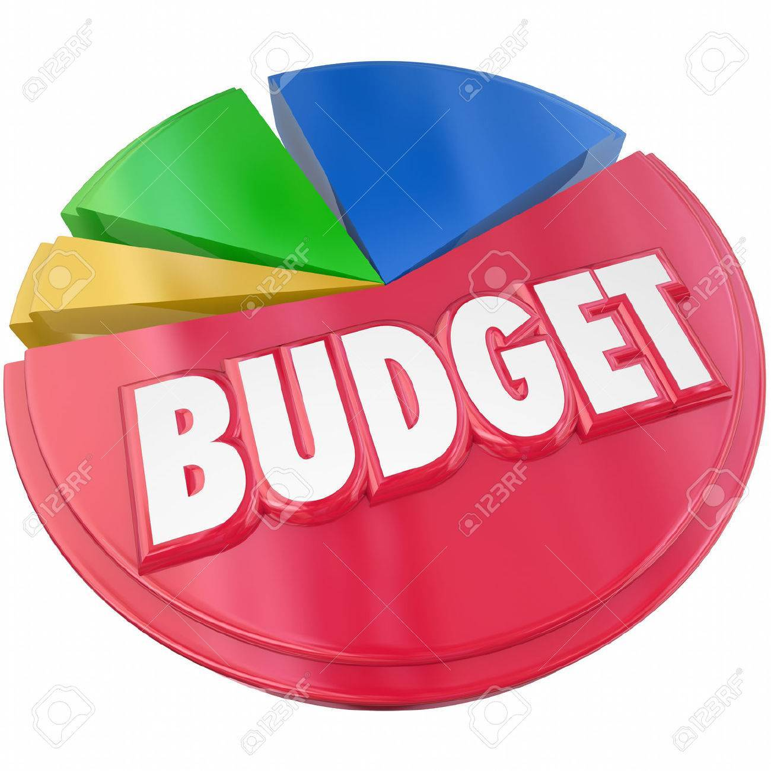
Create the budget
Venue Costs
Production Costs: Audio Visual
Catering Expenses
Decoration Expenses
Rental Expenses
Food and Drink Costs
Entertainment Costs
Marketing Costs: printing, mailings, video production, etc.
Meeting Expenses
Notes:
TIP: It’s wise to keep your costs for the event around 8% of your dollars raised. So if you’re goal is to raise $100,000 – keep your costs to $8,000 or less.

Slide 6
Fundraise and secure sponsorships
Will you be using crowdfunding? Are you asking participants to help you raise the money directly or indirectly?
Will you be getting sponsors for the event? What are the different levels of sponsorship? Will there be in-kind opportunities? Identify those needs and build them into your sponsorship package. Share with sponsors what they are getting out of it!
Will you be selling tickets to the event? (Determine pricing and where to sell the tickets.)
What software will your team use to streamline all the information, donations, and data you will be collecting?
EXAMPLE: 2024 Pickleball Tournament Sponsorship Opportunities

Slide 7
Design your event
What venue will you be using?
What is the date and time for the event?
What kind of experience do you want your guests to have?
What type of theme will you be incorporating?
What kind of program will occur during the event? What tools do you need to make that happen?
What type of decor will you be using? (This includes decorations, music, smells, visual background elements, entertainment, and guest speakers.)
How will the floor layout be for the big day?
What food and drinks will you be serving?
What will the specific roles be for your volunteers and staff?
How will you handle registration and security during the event?
What transportation options will you have? Will there be parking available?
How will you handle emergencies? (Medical, Power Outage)
Do you need an alternative date incase of a cancellation?

Slide 8
Recruit volunteers
Create volunteer roles with detailed descriptions.
  Look at what people have been successful at in the past! How can they contribute to your event?
  Are the people you’re identifying passionate about your mission?
  Have current volunteers recruit people they have worked with and have confidence in!
  Ask volunteers how they want to be involved. What are their strengths?
  Set the expectations up front.
  People really do want to know what the job is and how much time they will be spending on the “job”
Show appreciation to your volunteers before, during, and after the event.
  Listen to your volunteers. As a director, your role is to listen and direct!
  MAKE IT FUN!

Slide 9
Marketing your event
Build a marketing plan!
How will you promote the event? (Mail, Email, Social Media, Flyers, Radio, Local News, etc.)
What elements will you need for the event? Video, photos, posters, programs?
Create a calendar noting when certain pieces will go out on what platforms.
  Invites will hit mailboxes Feb 1
  Social media posts telling people to “watch their mailboxes”
  Follow up emails reminding people to RSVP
  Due date for materials: IE: information for programs must be submitted by Feb 20th to go to production Feb 25th
  Ask your volunteers to LIKE and SHARE!

Slide 10
Host your event!
On the big event day, there will still be a great number of tasks and logistics to manage to ensure all your organization’s event planning pays off. While hosting an event can be very rewarding, it’s important to keep your eyes on the prize to ensure all your volunteers, staff, vendors, and entertainers are set up for success.
Communication is absolutely essential to keeping everyone on the same page. A strong timeline is important so that all parties know what’s happening the day of the event!
As long as your team is on the same page, your event should go off without a hitch.
Example: Friday & Saturday Gaudeamus Schedule

Slide 11
Post event follow-up
After the event has come and gone, it’s a good idea to follow-up with your guests, send thank you notes, and ask for any feedback.
Survey: put a QR code in the program for immediate feedback
Thank you emails and phone calls
Photo albums
Sorry We Missed Yous!
  Email/mail event details to the invitees who didn’t attend with an overview of the success! Tell them that it’s not too late to participate!
  It will also be a good time to sit down with your team and create a comprehensive post-event checklist.
Notes:
Post event comprehensive over-view: Doing this will help you see what areas you need to work on for future events, what went wrong, what steps didn’t work, and what aspects of the event worked great. These follow-up steps will also be a good way to determine if you meet your event objectives.

Slide 12
Tips and tricks
Talk to people who have hosted similar events!
Get professional help! If you can afford a production company to help with the run of show, seek one out.
Don’t sweat it – you may be the only one in the room who knows when something goes wrong.
Smile! If you seem fine, your volunteers and guests won’t question a thing ☺

Slide 13
Questions & answers
THANKS FOR ATTENDING
Please don’t hesitate to reach out with questions after today!
ameara@archkck.org
C: 913.808.8926

